Slide 1
A Presentation at the NOG Conference & Exhibition in Abuja, Nigeria
3rd July, 2019
By
Enorense Amadasu
Deputy Director & Head, Upstream Monitoring & Regulation
THE DEPARTMENT OF PETROLEUM RESOURCES (DPR)
NIGERIAN OIL AND GAS REGULATORY AGENCY
“Upstream Opportunities in the Nigerian Oil and Gas Industry ”

Slide 2
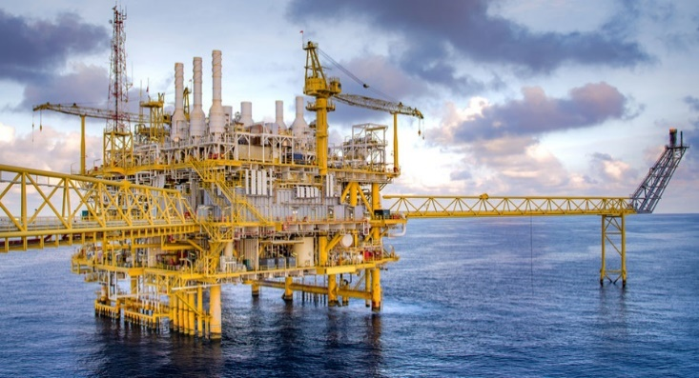
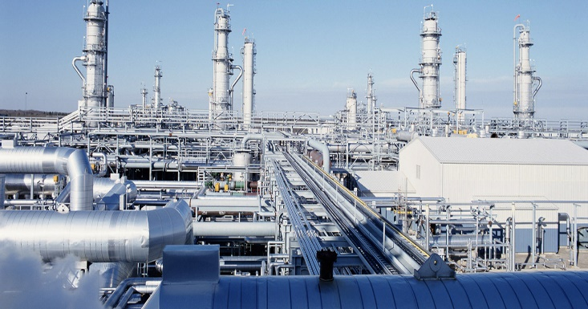
National Aspirations for the Oil & Gas Sector
  Upstream
    Oil Reserves – 40 Billion Barrels by 2020
    Gas Reserves – 200 TCF by 2020
    Oil Production – 3 Million Barrels Per Day
  Reserves(01/01/19) and Production Status
    Oil + Cond. Reserves – 37 Billion Barrels
    Gas Reserves – 200.79 TCF
    Production(oil +Condensate) – 2.1 MBOPD
    Daily Gas Production – 8.2 BCF/Day

Slide 3
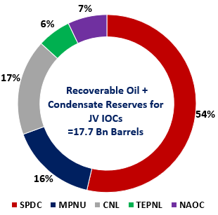
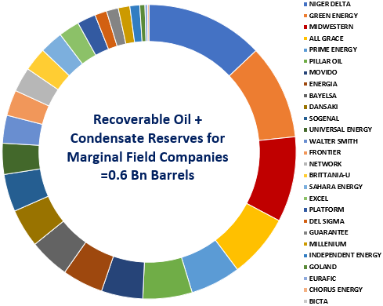
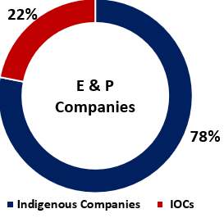
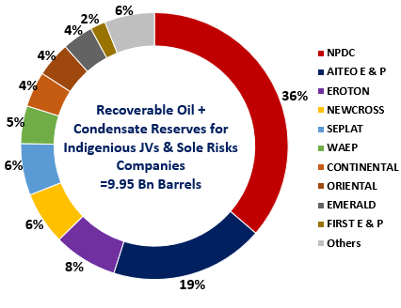
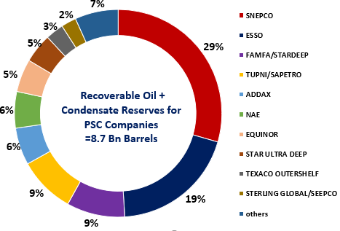
Industry E&P Active Players and Reserves
Eighty six (87) E&P companies

Slide 4
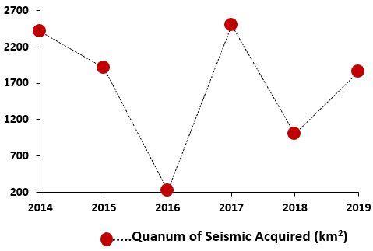
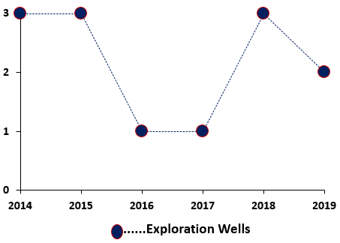
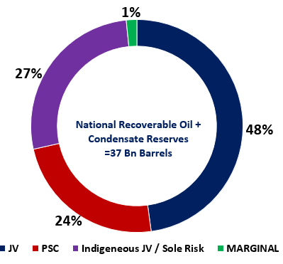
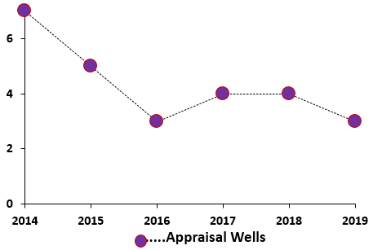
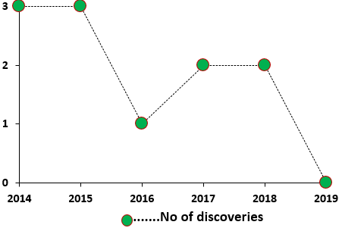
5-Year Performance: Upstream Dashboard

Slide 5
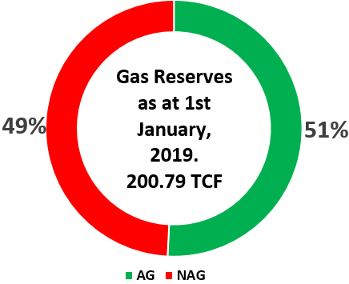

The Nigerian Gas Sector – A Dashboard
201 TCF
192
Gas Reserves
199
TCF
201
??? TCF
8.24
Gas Production
7.43
BSCFD
8.06
Export Market
Domestic Market
Field/Plant Use
Flare
The Fundamentals for Nigeria’s gas development are Strong. The National Gas Policy, Gas Commercialization & Network Code will help unleash its Hidden Potentials
LNG / WAGP
POWER /
INDUSTRIAL/
COMMERCIAL
FUEL/
GAS LIFT/
RE-INJECTION
FLARE
40%
43%
41%
16%
17%
17%
33%
30%
33%
11%
10%
9%
2017
2018
2019

Slide 6
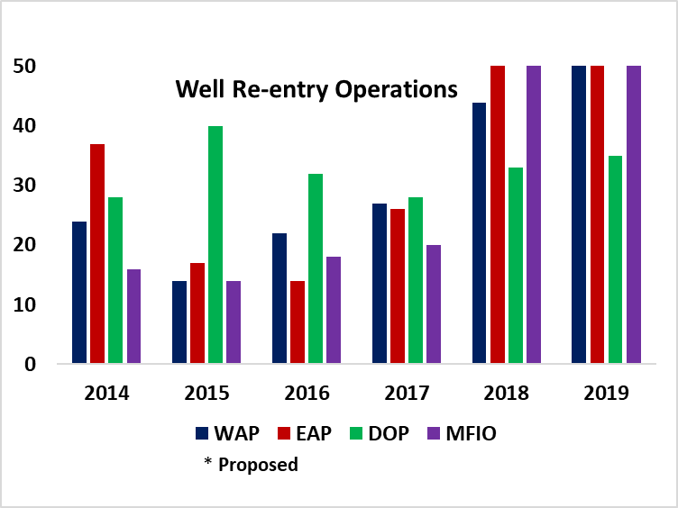
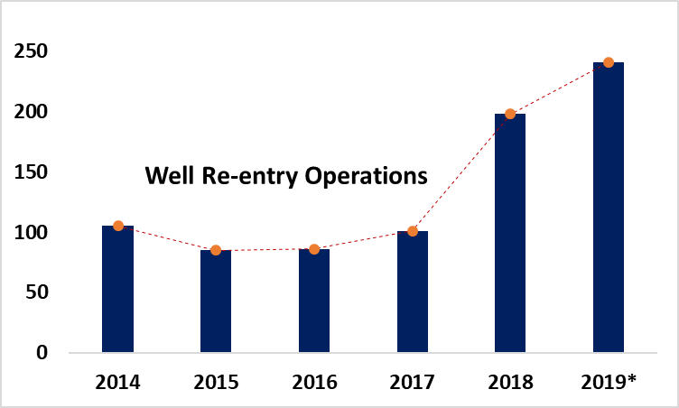

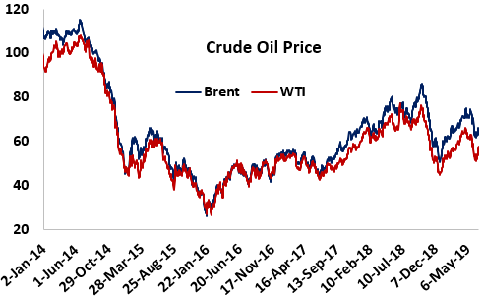
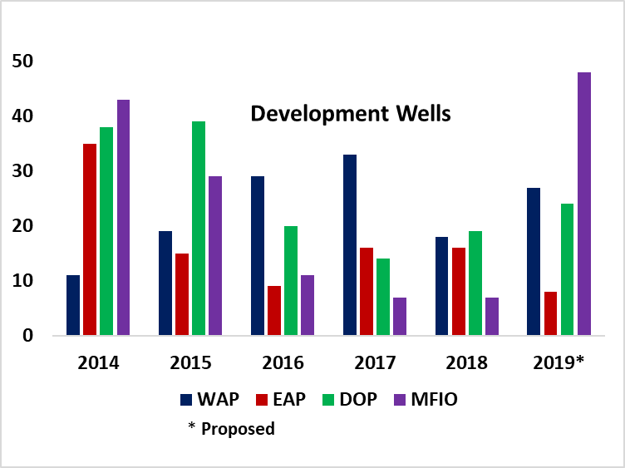
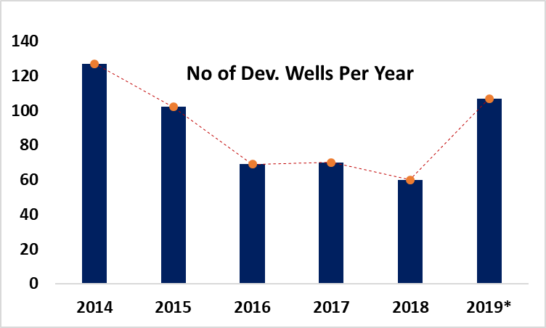
Investment Opportunities Enabler: Crude Oil Price
Crude oil price benchmarks: Historical trends for West Texas Intermediate (WTI) and Brent Crude
Opportunities in well operations
The outlook presents even more opportunities in the future. Investor’s confidence largely dependent on oil price

Slide 7
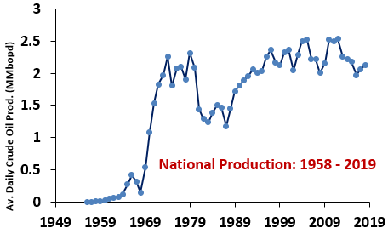
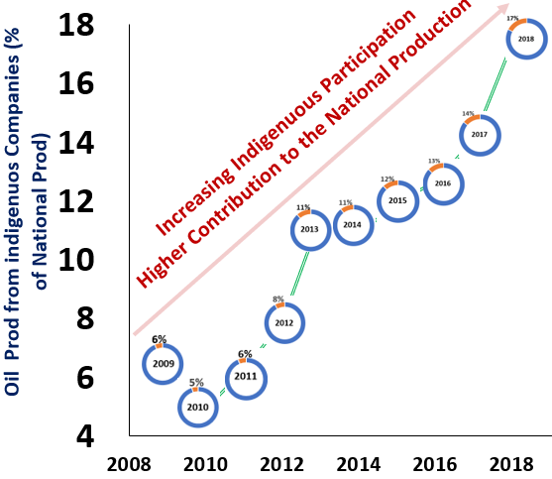
Investment Opportunities Enabler: Production
Significant increase in production from Deep water – 38%
Indigenous E & P Companies have Increasingly Played Significant Role in this History

Slide 8
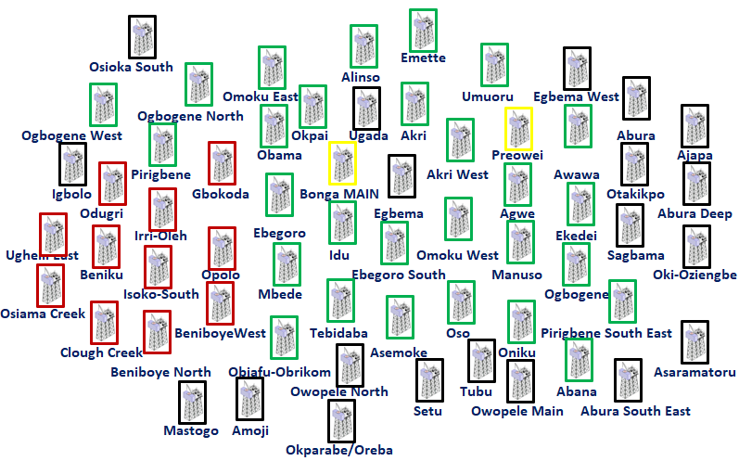
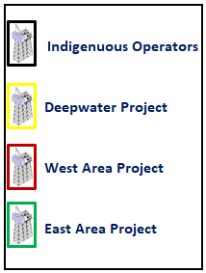
Investment Opportunities Enabler: Field Development Plans
Several Projects at Field Development Planning Stage present opportunities for Field studies and huge $Bn investment Opportunities

Slide 9
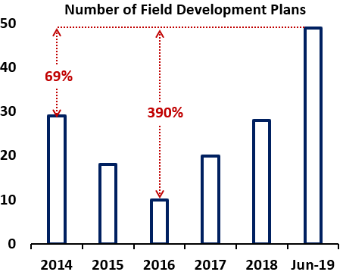
Astronomical Increase in FDPs
The numbers are also influenced largely by the crude oil price.
With development comes huge investment opportunities in activities such as:
Rig Supply and Leasing
Drilling Services
Allied Services
Equipment Supplies (Rigs, FPSOs, FSOs, EPF etc.)
Pipeline Construction
Gas Processing Plants Partnership
Operations & Maintenance Services

Slide 10
Opportunities Across Upstream Value Chain
Acreage Acquisition
Seismic Activity
Exploration Drilling
Appraisal Drilling
1. Bid rounds
2. Farm-in Opportunities
3. Technical and Financial Partnership
1. Equipment Supply
2. Equipment Leasing
3. ‘Acquisition Vessels’ for offshore Terrains
1. Rig Supply and Leasing
2. Drilling Services
3. Allied Services
4. Inland Basins
1. Rig Supply and Leasing
2. Drilling Services
3. Allied Services
4. Consumables
Field Development Planning
Development Drilling
Development Execution
Operations
1. Development of Upstream Fields
2. Strategic Partnership
3. Ultra Deep water
1. Rig Supply and Leasing
2. Drilling Services
3. Allied Services
1. Equipment Supplies (Rigs, FPSOs, FSOs, EPF etc.)
2. Pipelines
3. Gas Processing Plants Partnership
1. Funding Partnership
2. Operations & Maintenance Services

Slide 11
Investment Opportunities in Deepwater
225
200
OML 145 – Uge field
200
OML 118 - Bonga Southwest / Aparo field
OML 133 – Bosi field
140
OPL 245 - Etan field, Zabazaba field
110
120
OML 130 - Egina field (currently ramping up)
OML 130 - Egina South field
60
50
OML 130 - Preowei Field
OML 139 - Owowo Field
New Field Development: Expected Rates (kopd)
OML 118 – Bonga field
OML 130 – Akpo field
OML 127/128 – Agbami Field
OML 125 – Abo Field
Mature fields
Infill drilling And Well Re-entry Programs

Slide 12
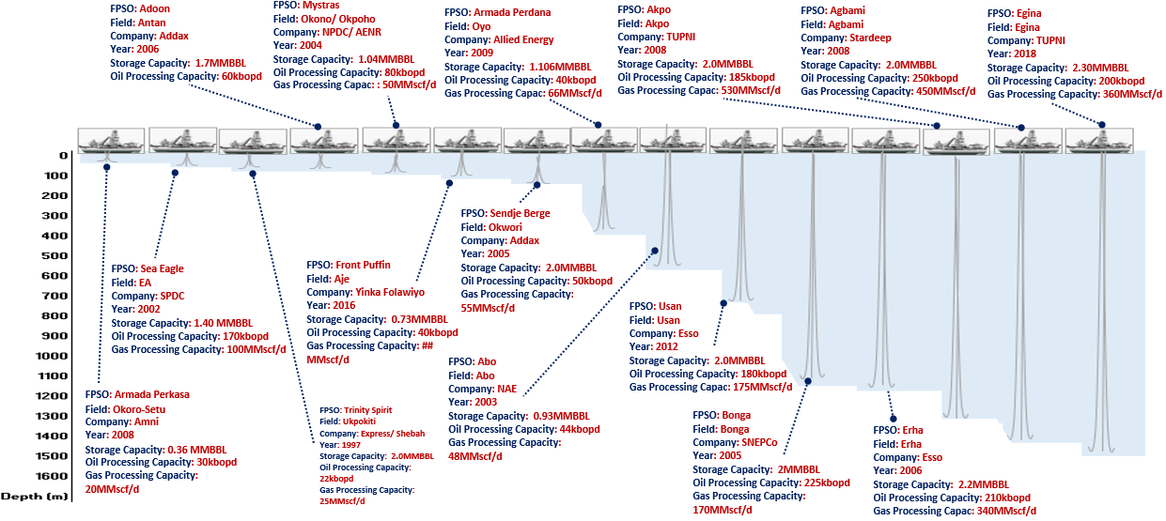
Business Opportunities in FPSO Deployment

Slide 13
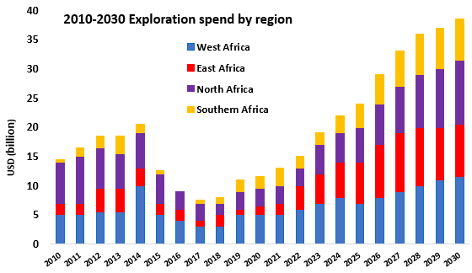

Discoveries and Exploration Spends – Africa in Perspective
$$−71\%$$
Huge decrease in amount spent in exploration between 2014 and 2018
Rystad Energy predicts an average 18% (Africa) and 15% (global) year-on-year increase in exploration spend for the 12 years period covering 2019 – 2030
Decline in discoveries; mostly due to challenges posed by above-ground risk (non-technical risk).
Projections for CAPEX is looking up for Africa; driven by the expected growth in Exploration in the East African region.
Data Source: Rystad, Pwc, EIA
Notes:
Exploration spend is an indicator of the value of investment or commitment towards exploration and discovery.
Africa experienced a massive drop in exploration spend of about 71% within the period between 2014 and 2017 . However, expert analysis reveal an average 18% per year growth in exploration spend for the next 12 years.

Slide 14
Acreages Administration Across Africa
Ghana: Ghanaian Licensing Round is ongoing: Six(6) blocks in the Tano/Cape with one block reserved for GNPC
Madagascar: Bid round for the exploration of fourty-four (44) offshore blocks in the Morondava Basin west of the island is ongoing
Cameroon: Launched a Licensing Round in 2018 for eight(80) blocks namely, Bomana, Bolongo and Bakassi in the Rio del Rey (RDR) Basin, and Etinde, Ntem, Elombo, Tilapia and Kombe/Nsepe in the Douala/ Kribi-Campo (DKC) Basin.
​Congo: License Round Phase II 2018-2019 is ongoing, and involves five (5) blocks in the shallow offshore, five (5) blocks in the deep and ultra-deep offshore, three (3) onshore blocks in the Coastal Basin and five (5) onshore blocks in the Cuvette Basin.

Slide 15
Acreages Administration Across Africa (2)
Nigeria: Nigerian Gas Flare Commercialization Programme (NGFCP). Programme Launch – Q3, 2018. 178 gas flare points have been identified
Gabon: launched its 12th Offshore Licensing Round in November 2018, with thirty-five (35) shallow and deepwater blocks. The bid deadline has now been extended from April to September 2019
Somali: The 1st Somalia Licensing Round, launched in London in February 2019. Fifteen(15) offshore blocks along the Somali Coastal Basin are being made available with bids due in November.
Angola: June 2019 - Namibe Basin and Ultra-deep lower Congo, and planned for 2020 - onshore Lower Congo and Kwanza Basins.

Slide 16
Acreages Administration Across Africa (3)
Equatorial Guinea: April 2019: All open acreage in Equatorial Guinea is to be made available in the EG Ronda 2019 including the Fortuna gas complex.
Uganda: Launched its 2nd Licensing Round in May 2019, acreage in the Albertine Graben.
Sudan: Plans to offer acreage in Q3 2019.
Mozambique: 6th Licensing Round in Q3 2019 is being planned, with acreages in the Zambezi and Angoche.
Egypt: Western Mediterranean acreage and frontier Red Sea acreage may be offered in Q3 2019 rounds

Slide 17
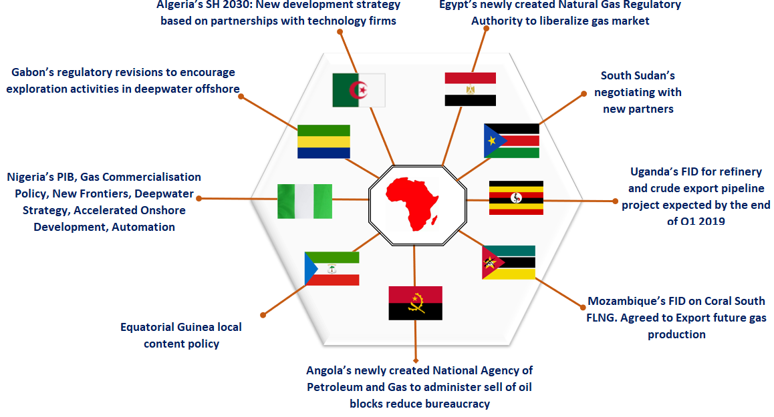
Business Opportunities in Upstream Landscape

Slide 18






The Deals that Count
>>>>The Hotspots Awaiting FIDs
1.
Deepwater Bonga North
Deepwater Bonga Southwest/Aparo
Assa North/Ohaji South
Ultra-deepwater Zabazaba-Etan project.
Owowo
Coral FLNG,
Anadarko’s Area 1 project
Nigeria
Mozambique
Fortuna FLNG
Equatorial
Guinea
Baltim SW project
Egypt
FLNG venture
Congo-
Brazzaville
Senegal
BP/Kosmos’ Tortue
LNG
Tanzania
LNG plant at Lindi

Slide 19



Look Ahead?
More Attractive fiscal and regulatory regime
Unique fiscal policy for unique emerging plays
Responsive legislative environments
Projections for capex and exploration spend in Africa are positives
Accelerated Lease Renewals
Gas Commercialisation
New License Awards on the open blocks
Opening up the frontier territory
Deep Play Exploration and Reserves Maturation
Concession Midstream Asset (Facility Synergy)

Slide 20


Slide 21
Growing Reserves and Boosting Production:
--------DPR Strategy
Acreage management
Early Lease renewal
New License Awards
Deep and ultra-deep development strategy
Regional Oil and Gas Hubs
Concession midstream assets (synergy in utilisation of production facilities)
Early FIDs
Incentives based on Reserves Additional Value (Reserve replacement through drilling or discover )
Fast Track field Development
Infill Development
Reserve Maturation (Technology based – Deeper Seismic probes, Regional 4D imaging, New drilling Techniques, Deep Play Exploration – HPHT Rigs, Deep Play Exploration)
Exploration in Inland Basin and Deepwater

